Slide 1
8086 Bus Timing & Wait state
The Intel Microprocessors 8th Edition by Barry B Brey
Section 9-4 Bus Timing page 315
Arnab Bhattacharjee
Lecturer, Department of CSE,
United International University
Email id : arnab@cse.uiu.ac.bd
Courtesy: Nasif M. Sir,
Md. Shafqat Talukder Rakin Sir

Slide 2
General Bus Operation
The 8086 has a combined address and data bus commonly referred as a time multiplexed address and data bus. The main reason behind multiplexing address and data over the same pins is the maximum utilization of processor pins and it facilitates the use of 40 pin standard DIP (Dual in-line package).
Basically, all the processor bus cycles consist of at least four clock cycles. These are referred to as T1, T2, T3, T4. The address is transmitted by the processor during T1. It is present on the bus only for one clock cycle.

Slide 3
Machine Cycles
A machine (bus) cycle consists of at least four clock cycles, called T states.
A specific, defined action occurs during each T state (labeled T1 – T4)
  T1: Address is output
  T2: Bus cycle type (Mem/IO, read/write)
  T3: Data is supplied / Data is received
  T4: Data latched by CPU, control signals removed
Notes:
1. T1 (Address Phase)
The processor places the address of the memory or I/O location on the address bus.
The lower 16 bits of the address are multiplexed with the data bus (AD0–AD15).
The Address Latch Enable (ALE) signal goes high, indicating that the address is valid and should be latched externally.
Status signals (like M/IO, S0, S1) are also generated.
Key idea:
T1 = Address is sent to the outside world
2. T2 (Bus Turnaround Phase)
The address is removed from the multiplexed lines, and the bus is prepared for data transfer.
The processor activates control signals:
RD̅ (Read) for read operation
WR̅ (Write) for write operation
The data bus direction is set:
Input for read
Output for write
Key idea:
T2 = Decide operation (read/write) and prepare the data bus
3. T3 (Data Transfer Phase)
Actual data transfer occurs:
In a read operation, memory places data on the bus.
In a write operation, the processor places data on the bus.
The processor samples or sends data during this cycle.
If the memory or I/O is slow, wait states (Tw) may be inserted between T3 and T4.
Key idea:
T3 = Data is actively transferred
4. T4 (Completion Phase)
The data transfer is completed.
Control signals (RD̅ / WR̅) are deactivated.
The bus is released and returns to idle state.
Key idea:
T4 = Finalize and clean up the operation

Slide 4
BUS Timing (Write/Read)
During T ₁ :
The address is placed on the Address/Data bus.
Control signals ALE and DT/ R’ specify memory or I/O, latch the address onto the address bus and set the direction of data transfer on data bus.
During T ₂ :
8086 issues the RD’ or WR’ signal, DEN’ .
DEN’ enables the memory or I/O device to receive the data for writes and the 8086 to receive the data for reads.

Slide 5
Bus timing
During T ₃ :
This cycle is provided to allow memory to access data.
READY is sampled at the end of T ₂ .
    If low, T ₃ becomes a wait state.
During T ₄ :
All bus signals are deactivated, in preparation for next bus cycle.
Data is sampled for reads, writes occur for writes.

Slide 6
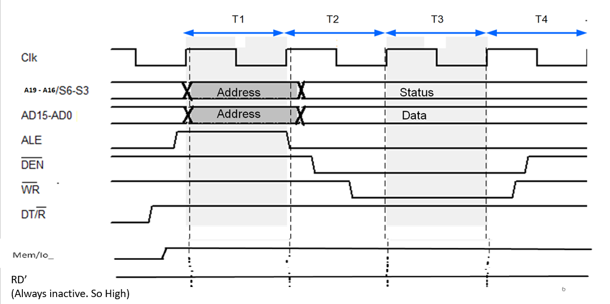
Bus timing for Write operation

Slide 7
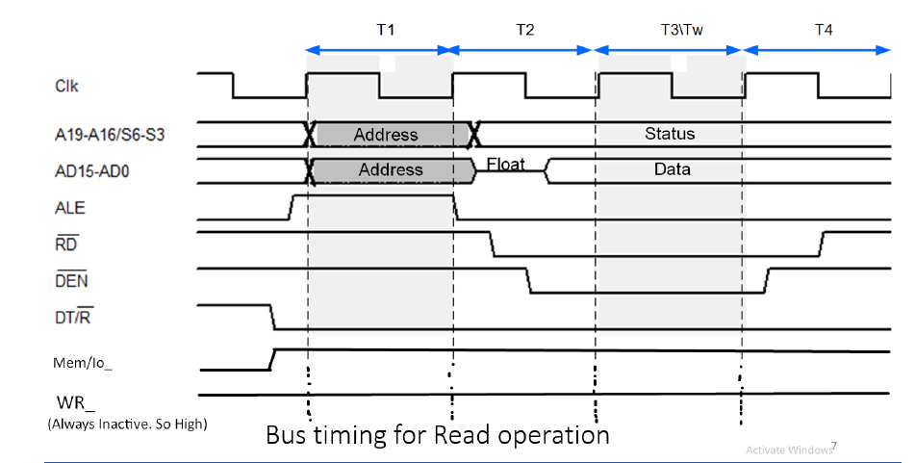

Slide 8
Ready pin and Wait state
The READY input causes wait states for slower memory and I/O components.
A wait state is a situation in which a computer processor is waiting for the completion of some event before resuming activity. A program or process in a wait state is inactive for the duration of the wait state.
When a computer processor works at a faster clock speed than the random access memory ( RAM ) that sends it instructions, it is set to go into a wait state for one or more clock cycles so that it is synchronized with RAM speed. In general, the more time a processor spends in wait states, the slower the performance of that processor.
Wait states are a pure waste for a processor's performance. Modern designs try to eliminate or hide them using a variety of techniques: CPU caches, instruction pipelines, instruction prefetch , simultaneous multithreading and others.

Slide 9
8086 Ready pin
The READY input is controlled to insert “Wait states” into the timing of the microprocessor. If the READY pin is placed at a logic 0 level, the micro-processor enters into wait states and remains idle. When it is high (logic 1), it indicates that the device is ready to transfer data.

Slide 10
Thank You

